Slide 1
Semantic Web, Linked Data and Knowledge Graphs
Group 09
José Manuel Díaz Urraco - Daniel Lobato Navacerrada - Eva Tagarro López de Ayala

Slide 2
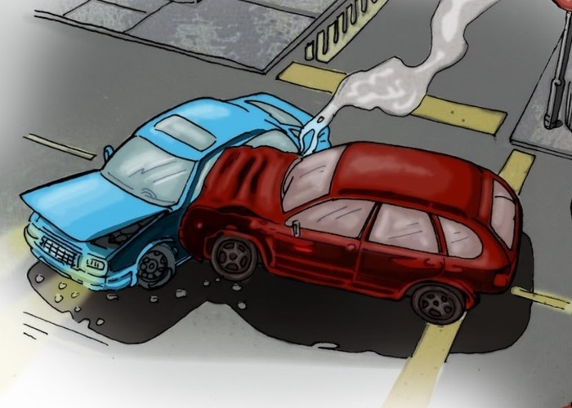
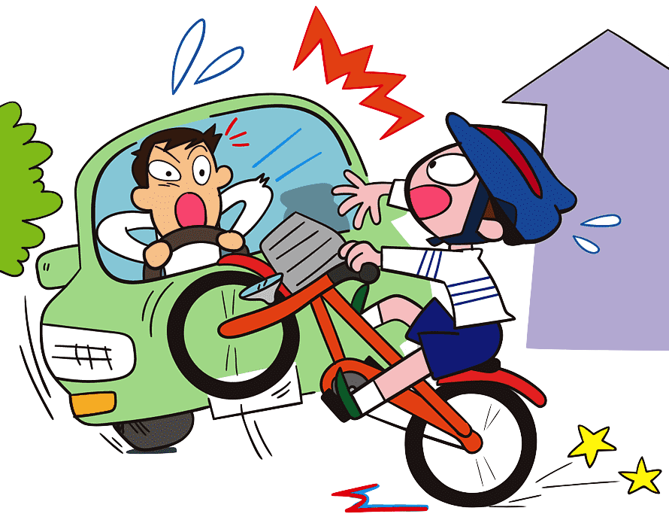
Data Source
Traffic accidents in the City of Madrid
Data source: https://datos.madrid.es/
Analysis of the data: street, district, date, type of accident and characteristics of people involved.
License: comercial and non comercial purposes.
Objective: search accidents by any criteria.

Slide 3

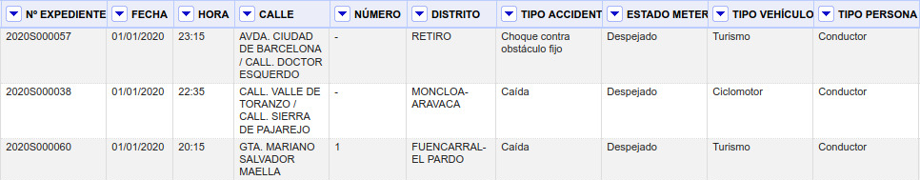
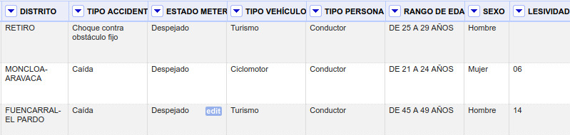
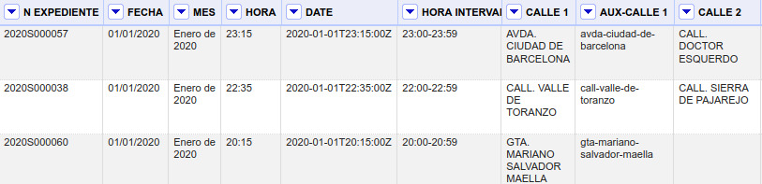
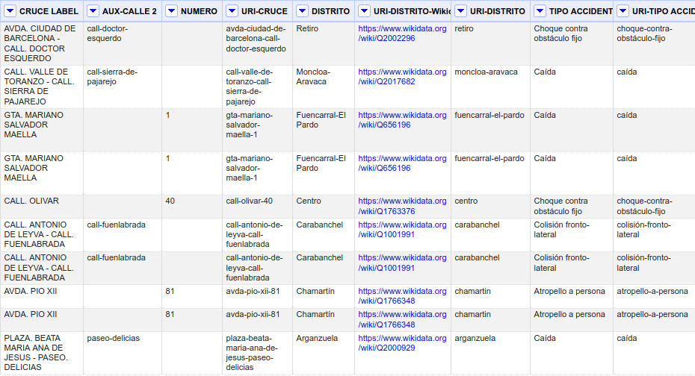
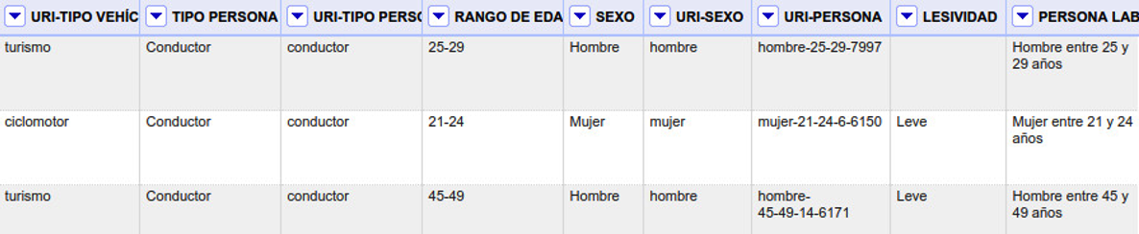
Original
Final

Slide 4
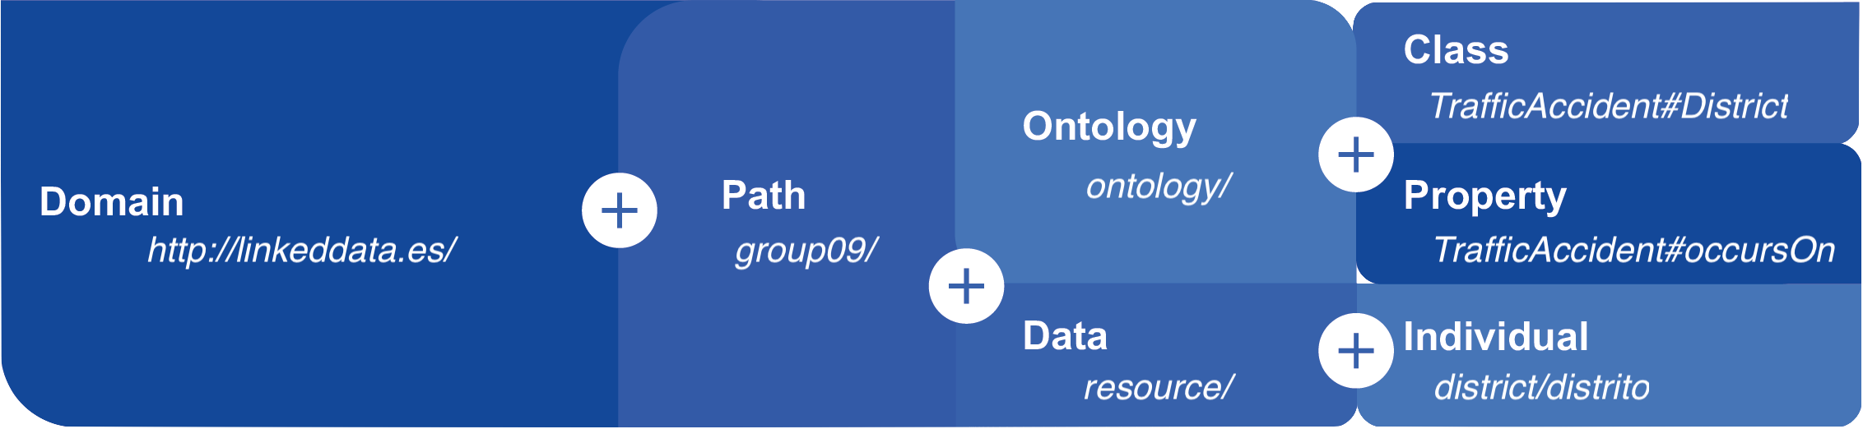
Resource Naming Strategy

Slide 5
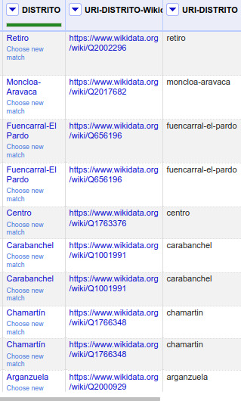

Linking with Wikidata
Matching: sharable, extensible, and easily re-usable.
Data connected from different sources.
Get properties and instances we do not have in our dataset.

Slide 6

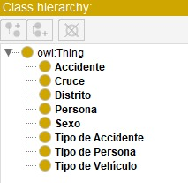
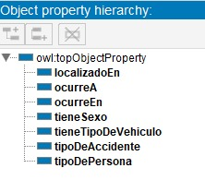
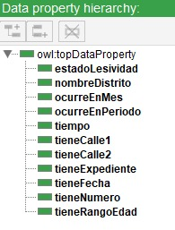
Ontology

Slide 7
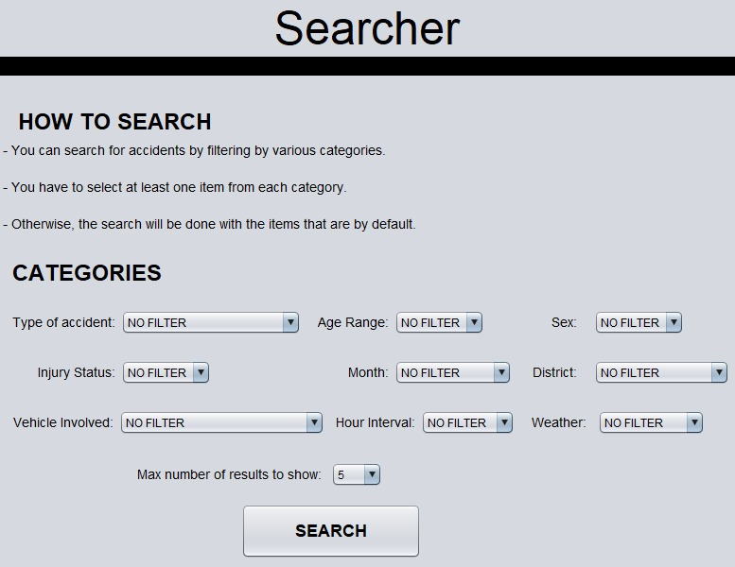
Application demo

